Slide 1
English Language
The course
Component 1
20th Century Fiction
Reading:
Read one text.
Answer questions about it.
Writing:
Write a narrative, to suit one of four unseen titles.
Component 2
19th & 21st Century Non-fiction
Reading:
Read two texts.
Answer questions about them, including a comparative question.
Writing: Write two responses to present a point of view on an issue.

Slide 2
Why bother?
* A grade 4 or higher must be achieved in Language or Literature to avoid resitting post 16*
GCSE English is essential if you want to access higher level courses.
GCSE English is essential in a competitive job market
Do it for yourself: Earn more money!
Do it for your parents!

Slide 3
Exam Papers
Component 1 tests your reading and writing:
One hour to answer questions linked to an unseen text.
45 minutes to write a narrative story, to suit one of the titles printed.
You must complete all questions.

Slide 4
Exam Papers
Component 2 tests your reading and writing:
One hour to answer questions linked to two unseen texts.
One hour to write two transactional and persuasive texts, like letters, reviews, speeches and articles.
You must complete all questions.

Slide 5
Preparation
Students must track texts carefully and explain meaning, with reference to the text – just like in the Literature papers.
Look at an exam paper and see for yourself what they will be tested on…

Slide 6
Example reading paper
List…
How does the writer…
What impressions
To what extent…
Only look where it tells you!
Read the question carefully, twice!
Look at the question stem.
Look at how many marks are available.

Slide 7
Question 1
Read lines 1-9.
List five reasons why Obed Ramotswe went to South Africa. [5]
Have a go!

Slide 8
Question 1
Read lines 1-9.
List five reasons why Obed Ramotswe went to South Africa. [5]
things were bad (in Botswana);
to (find) work;
his father said he should go / encouraged him;
the family’s lands were not good enough to support Obed and a future wife;
they did not have many cattle for food/money;
they grew just enough crops/didn’t make any money out of farming;
he felt a sense of obligation / duty to his family.
No mark should be awarded for unabridged quotation of whole sentences.

Slide 9
Question 3
Read lines 18-30.
What impressions do you get of the work in the mines from these lines? [10]
Have a go at finding an answer or two…

Slide 10
Question 3
Read lines 18-30.
What impressions do you get of the work in the mines from these lines? [10]
Give 9-10 marks to those who make accurate and perceptive comments on a wide range of examples about what it was like to work in the mine and provide detailed analysis of how language and tone are used to achieve effects and influence the reader. Subtleties of the writer’s technique are explored in relation to how the reader is influenced. Well-considered, accurate use of subject terminology supports comments effectively.

Slide 11
Question 3
Read lines 18-30.
What impressions do you get of the work in the mines from these lines? [10]
it was harsh / horrible / grim / bleak
it was physically demanding
it was hot
it was dangerous
the miners were strictly ordered about / no kindness or respect / functional language
it was frightening / daunting
it was dark and dusty
they worked long hours
they were well-paid (relatively)
an impression of care but it was impersonal / dubious motives.
Notes:
Example answer

Slide 12
Question 3
Read lines 18-30.
What impressions do you get of the work in the mines from these lines? [10]
By describing the mine as a place where ‘the rock could fall and crush’ the men, we get the impression that it is a harsh environment, full of danger. It seems a bleak and grim place to work, with Ramotswe revealing that miners spoke a language with ‘no words for love, or happiness’. The fact Ramotswe worked for ‘ten hours every day’ creates an impression of a gruelling, and physically demanding job where the workers are pushed to their limit.
Embedding the evidence
Use question words
Explain meaning
Use quotations to help explain ideas
Notes:
Example answer

Slide 13
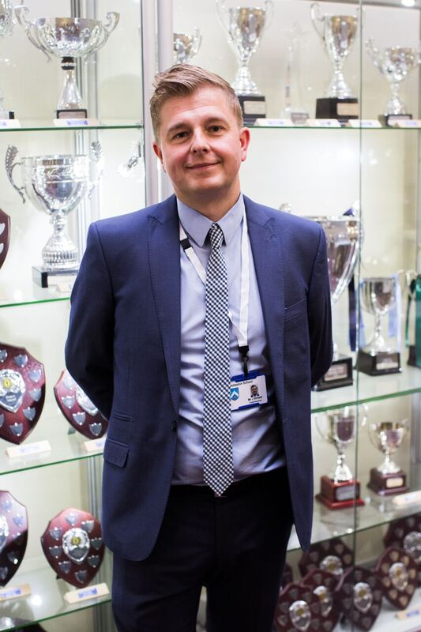
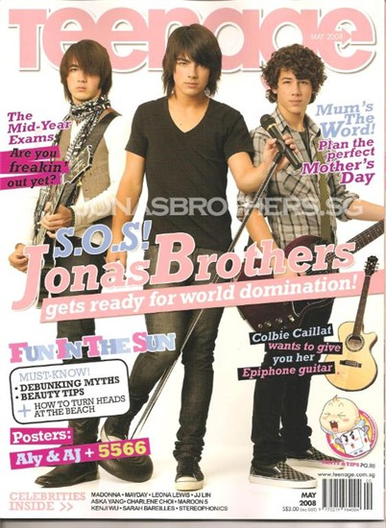
Example writing paper
Students will be asked to write two pieces
They should spend 30 minutes on each section
One task will ask students to write formally and the other informally
Tasks include: Writing a letter to a Headteacher or an article for a teenage magazine.

Slide 14
How to succeed…
As this is a written task, the basics apply:
Identify the Purpose, Audience and Format before you begin. As you write, keep these in mind as they will influence your tone.
Use interesting and adventurous words
Use paragraphs
Use a variety of sentence types
Use a variety of punctuation
Be detailed and specific with everything you write
ACCURACY IS EVERYTHING
Keep in mind the type of text you are writing, your audience and a clear purpose- TAP!

Slide 15
Write a letter to the Headteacher of your school giving your opinions on school dinners.
Start strong. Don’t sit on the fence! Be opinionated.
My name is John Smith and I am writing to talk about school dinners. In some ways they are good, in others bad, and I would like to give my opinion on what I think of them…

Slide 16
Write a letter to the Headteacher of your school giving your opinions on school dinners.
Start strong. Don’t sit on the fence! Be opinionated.
My name is John Smith and I am writing to talk about school dinners. In some ways they are good, in others bad, and I would like to give my opinion on what I think of them…

Slide 17
Write a letter to the Headteacher of your school giving your opinions on school dinners.
Start strong. Don’t sit on the fence! Be opinionated.
My name is John Smith and I would like to express my delight at the wonderful range of food currently served in our school canteen. It is a real joy to be able to choose from so much…

Slide 18
Write a letter to the Headteacher of your school giving your opinions on school dinners.
Start strong. Don’t sit on the fence! Be opinionated.
My name is John Smith and I would like to express my delight at the wonderful range of food currently served in our school canteen. It is a real joy to be able to choose from so much…
Notes:
Flip it and change the view to a negative one, using strong opinionated vocabulary.

Slide 19
Time is Ticking
Begin to Prepare Now!

