Slide 1
Mathematics
How to help your child with maths

Slide 2
Exam Board - Edexcel
As you will be aware, your students are studying for GCSE Mathematics qualification with grades from 9-1.
There are two tiers, Foundation and Higher.
Foundation grades 1-5
Higher grades 3-9
Students have to resit unless they secure a 4

Slide 3
Exam info:
Three exam papers
Each paper is 1 hour 30 minutes
Any topic could be on any paper, but the 1st paper is non-calculator, followed by two calculator papers

Slide 4
Equipment
It would really help students to have their own equipment and calculator to use now and to practise with at home.
All students need a scientific calculator. We recommend the Casio fx-83GT PLUS
They need compasses, a ruler, a 360º protractor.
All items are available in the school shop.

Slide 6
Higher or Foundation?
Sets 1and 2 are on track to sit the Higher paper.
Sets 3 and 4 are on track to sit the Foundation paper
Selected students in set 3 may move to Higher depending on their mock result in year 10

Slide 8
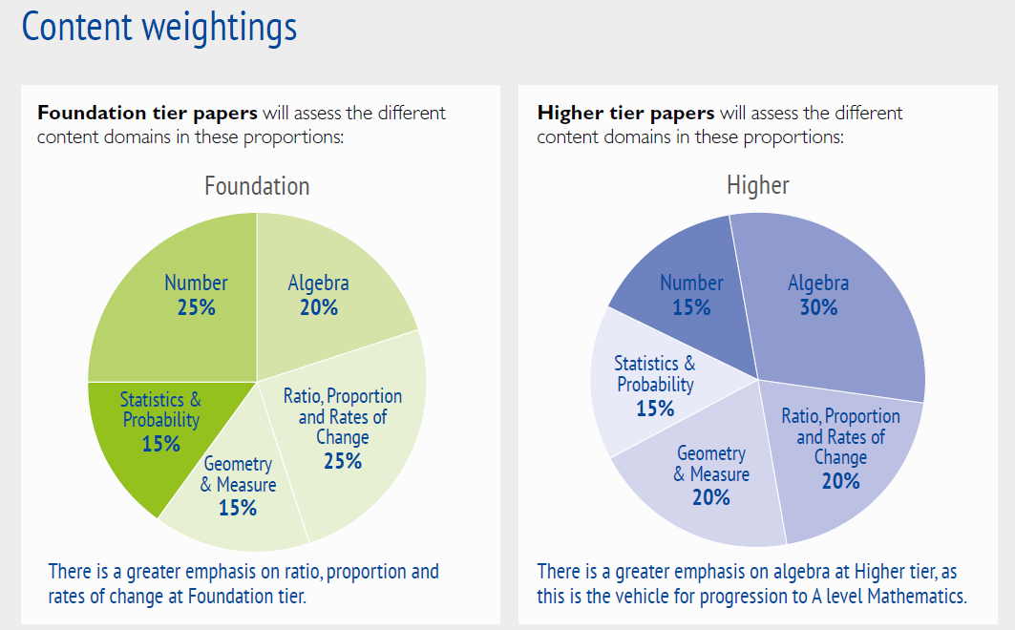

Slide 9
Types of questions on the papers
There is a bigger emphasis on problem solving.
The breakdown of papers is:
Using and applying standard techniques, straight forward using maths. (50% of Foundation papers, 40% of Higher)
Reasoning, interpreting and communicating mathematically (25% of Foundation and 30% of Higher)
Solving problems, can be mathematical and non-mathematical contexts (25% of Foundation and 30% of Higher)

Slide 10
Sparx Maths
Online platform for extended and independent learning tasks
Expectation is 50 minutes per week minimum “active time” on sparx homework. Tasks are set weekly
Students are encouraged to write down their methods – bookwork checks
Independent learning facility allows students to recap on prior learning or try extension tasks.
Support clubs are on offer every Monday and Tuesday during lunchtime in IT2

Slide 11
Helping your son/daughter with maths
100% attendance to all lessons with all equipment including a calculator
Talking about Sparx tasks – reminder of deadlines. It’s always set Wednesday and due Wednesday for all year groups.
Practice maths not just reading about maths. Small chunks, but regularly.

Slide 12
How to succeed
Be clear on what you need to study
Plan what you are going to revise and when
Keep your revision interesting
Practice non calculator questions
Practice with your calculator
Practice past papers and in exam conditions

Slide 13
Top Tips
Tip 1: Believe in yourself. Get rid of negative thoughts.
Tip 2: Don’t revise, instead practise.
Do questions on topics you aren’t so good on
Practise checking your work
‘Don’t practise ‘til you get it right. Practise ‘til you can’t get it wrong.’
Tip 3: Always, always mark your work when you try exam questions.
If you get a question wrong, try it again. If you need to watch a video on that topic before re-trying.
Tip 4: Start today – Work on Maths everyday

Slide 14
Useful Websites
Mathswatch
Mathsgenie
Corbettmaths
Onmaths – Complete papers online that get marked immediately

Slide 15
