Slide 1
Success at GCSE Evening

Slide 2
Overview of the evening
Introduction presentation: how you can support guiding your child to academic success over the next two years
Subject specific support sessions: led by Heads of department.
English Lit: (SO1)
English Lang: (SO2)
Maths: (FO3)
Science: (IT3)

Slide 3
What to expect from GCSE qualifications
Students will be working at their highest level yet.
1
Lessons will be challenging and rigorous with lots of different learning opportunities.
2
Homework will stretch students learning and prepare them for next topic/focuses
3
Regular feedback will be given so students know how they can improve within their subjects.
4

Slide 4
Importance of Year 10
Year 10 is a crucial foundation year for GCSE success.
Students begin most GCSE content and learn essential skills for exams.
Early support can set the tone for effective study habits and confidence.

Slide 5
Students could feel a range of emotions of the next two years which may present as…
Frustration
Stress
Nerves
Anxieties
Tears

Slide 6
How can you help at home? Simply – talk, talk and talk about learning. Basic questions such as ‘what did you learn today? Can you tell me something you remember from today’s lessons? The more you talk, the more retrieval takes place and the more retrieval takes place, the more likely information is going to be stored in the long term memory.

Slide 7
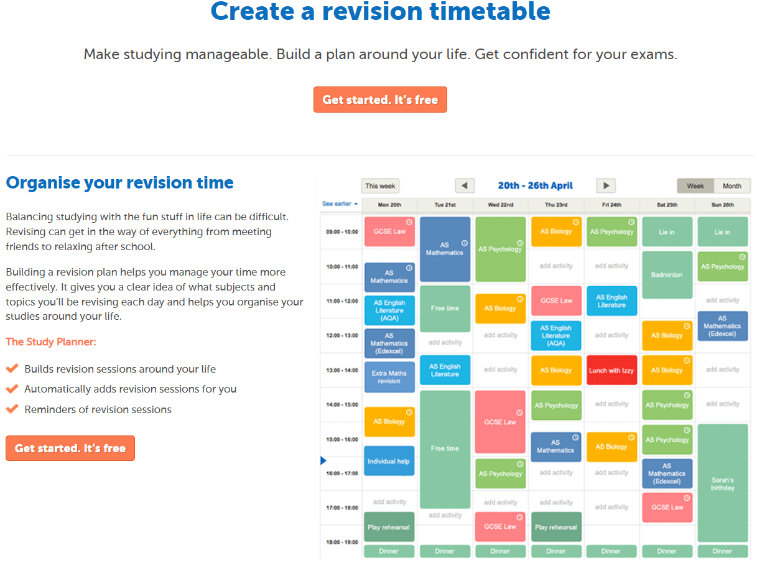
Create a revision schedule
https://getrevising.co.uk/planner
Use a revision planner and encourage revision on a regular basis. Again, this helps to use retrieval skills which over time will help students to retain knowledge in their long term memory.

Slide 8
Support Healthy choices

Slide 9
Eat Well
Maintain a balance diet
Avoid high fat/ high sugar/ high caffeine food and drink
Healthy snacks
Don’t skip meals to study
Try to eat before exams
Keep hydrated

Slide 10
Sleep
Good sleep improves thinking and concentration
Most teenagers need 8-10 hours sleep
Try to have at least half an hour ‘down time’ between studying and trying to go to sleep
Avoid cramming all night as this will not be productive, meaningful study
TURN THE PHONE OFF!!!

Slide 11
Exercise
Boosts energy levels
Clears the mind
Great stress reliever

Slide 12
Building healthy study habits
Short but regular revision session – 20-30 minutes focused blocks with breaks
Use of revision tools – Flash cards, mind maps and online resources like GCSEPod and Sparx
Review Past papers – Practice exam-style questions to buld confidence

Slide 13
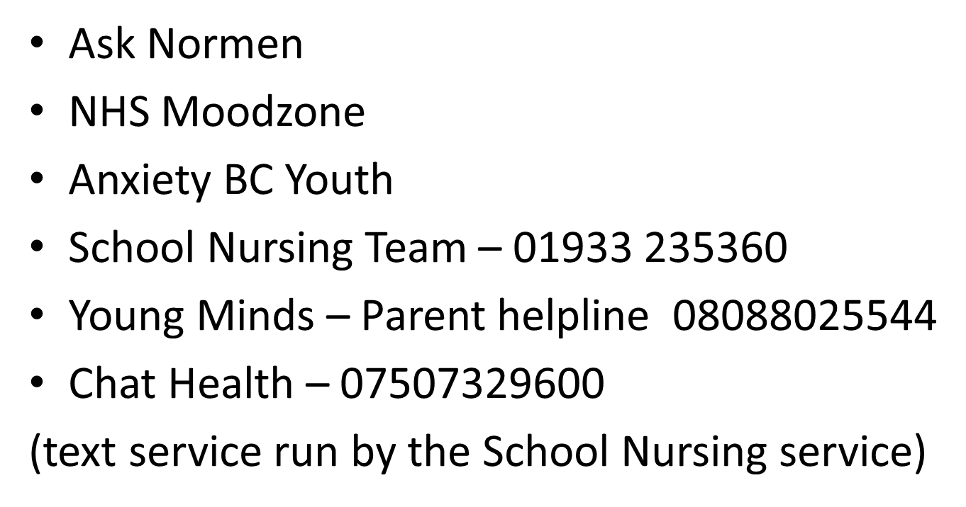
Seek guidance and support
As a school we are always here to support our young people on their school journeys. But there are also other agencies which parents can contact.

Slide 14
Final tips
Be supportive and positive about their efforts
Avoid comparisons with siblings and peers
Celebrate small successes and progress
Keep the communication lines with school open

Slide 15
Pupil Premium Funding
Additional funding available for those who are eligible.
Funding available for trips & visits, resources, curriculum materials like workbooks or revision guides etc.
Key contact: Lee Towers, Deputy Headteacher.
Email: towersl@wollaston-school
North Northamptonshire: https://www.northnorthants.gov.uk/schools-and-education/free-school-meals-and-pupil-premium
West Northamptonshire:
https://www.westnorthants.gov.uk/help-cost-going-school/free-school-meals-and-pupil-premium

